Slide 1
Q1) Write JavaScript code to demonstrate RegExp object using search, replace & test methods.

Slide 2
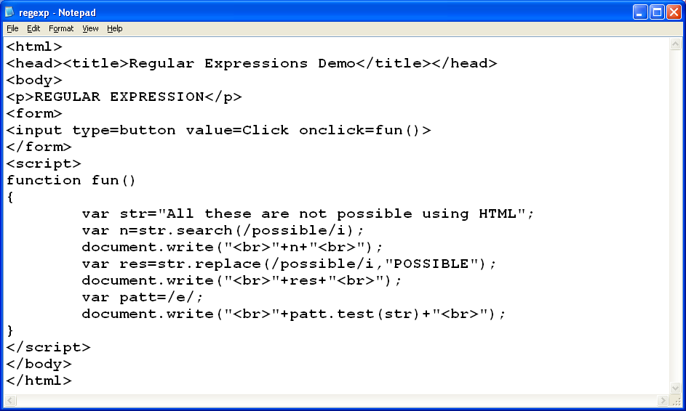

Slide 3
Q2) Write JavaScript code to demonstrate String object. Make use of length attribute.

Slide 4
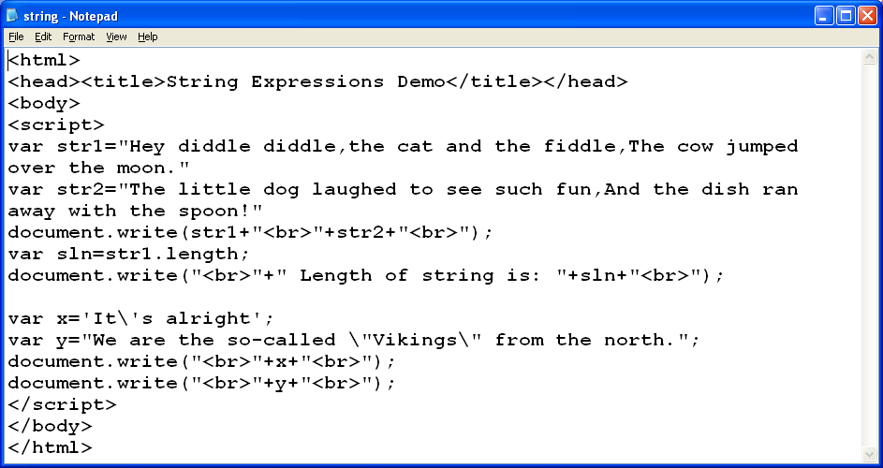

Slide 5
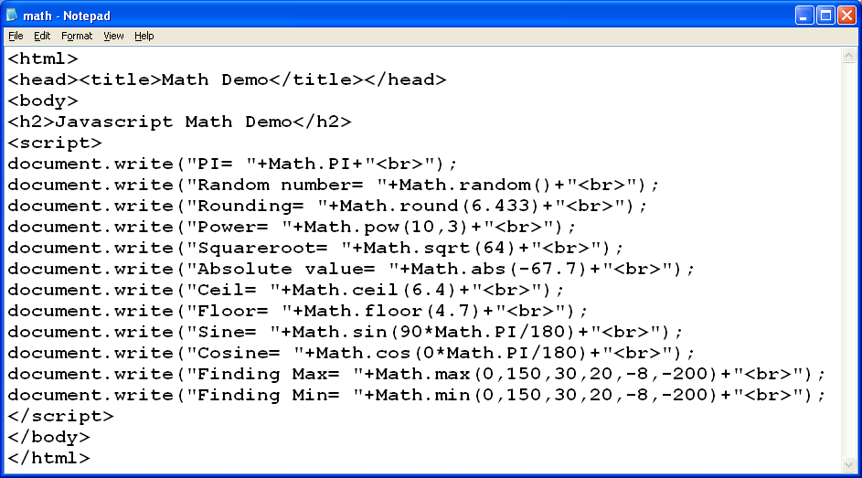

Slide 6
Q4) Write JavaScript code to demonstrate Date object with different parameters.

Slide 7
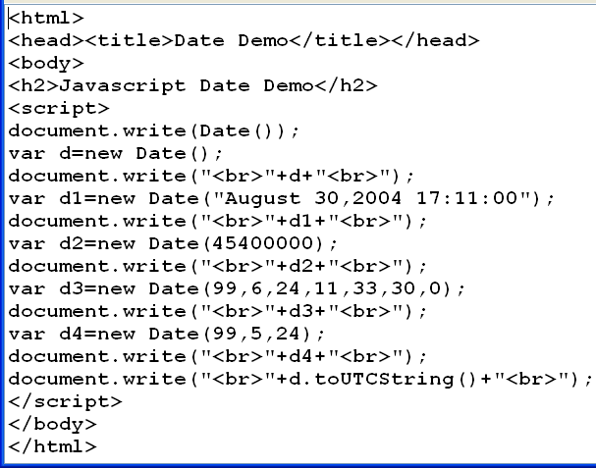

Slide 8
Q5) Write JavaScript code to demonstrate Window object of JavaScript.

Slide 9
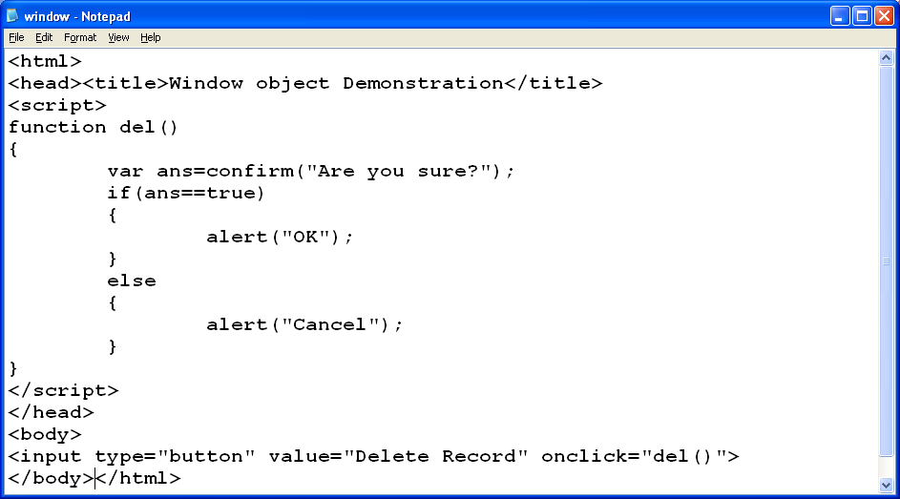

Slide 10
Q6) Write JavaScript code demonstrating various attributes of Navigator object.

Slide 11
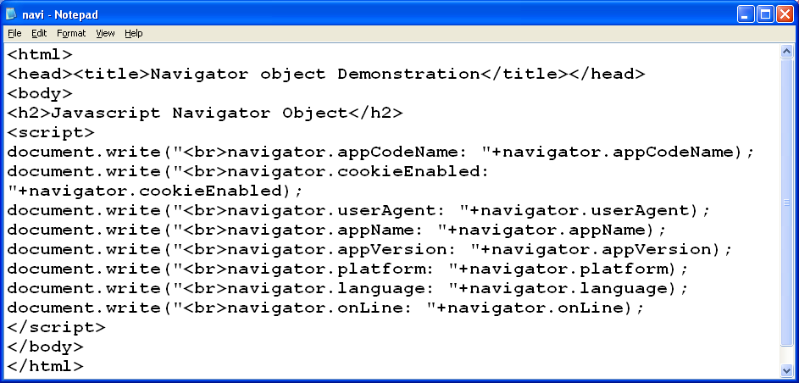

Slide 12
Q7) Write JavaScript code to know how many times a user have visited a webpage using JavaScript History object.

Slide 13
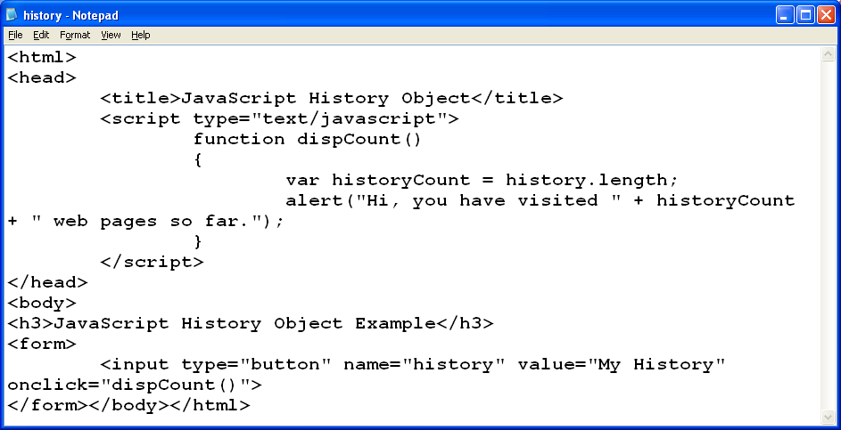

Slide 14
Q8) Write JavaScript code demonstrating various attributes of Location object.

Slide 15
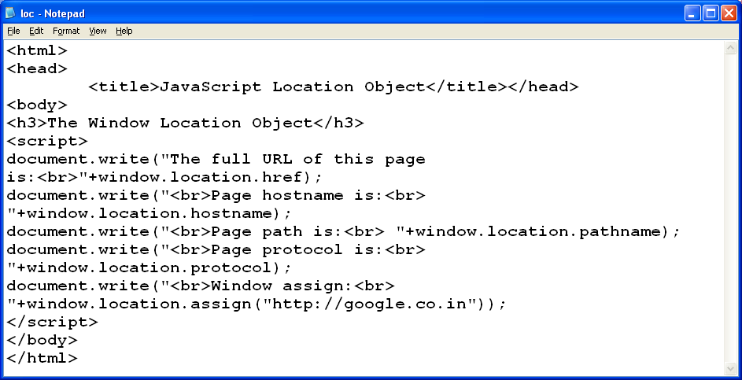

Slide 16
Q9) Write a JavaScript code program which takes name from the user & stores it in the form of cookie in the form of “key=value” pair.

Slide 17
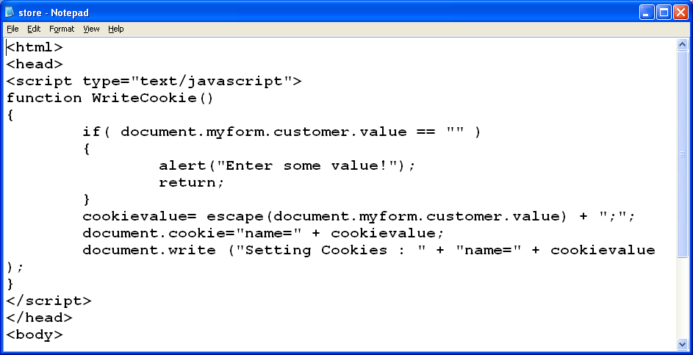

Slide 18
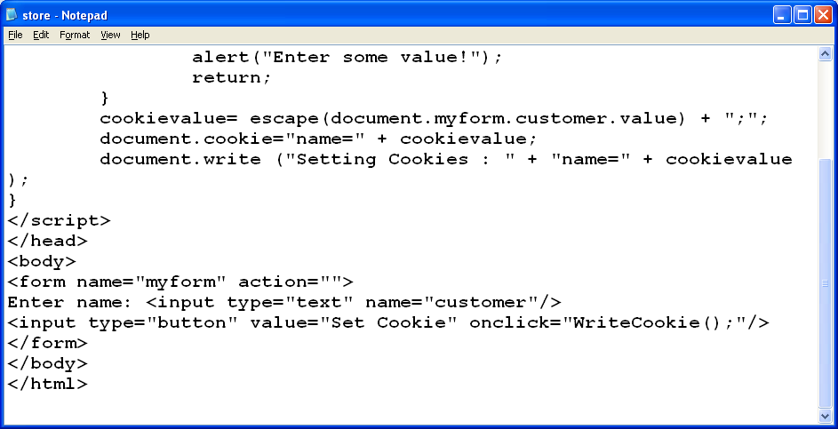

Slide 19
Q10) Write a JavaScript code program which retrieves all the cookies stored in the browser in the form of “key=value” pair.

Slide 20
